Slide 1
Aerodynamics

Slide 2
Who are we?
Why are we here?
Notes:
Use this slide to get students involved in the presentation early

Slide 3
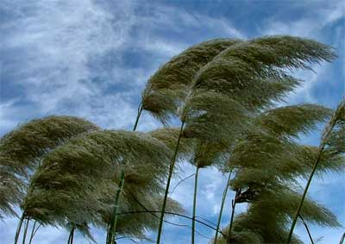
WIND
Notes:
Explain that the PSI stands for Pounds Per Square Inch. Maybe even draw a small box on the board about the size of a square inch, just to reinforce just how small a square inch really is. Finally, let the students know that most cars weight less than 3,000 pounds.

Slide 4
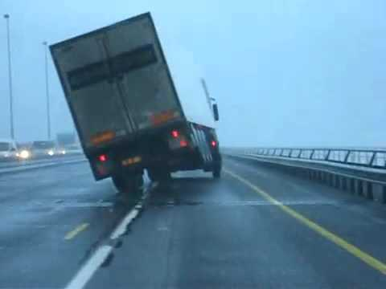
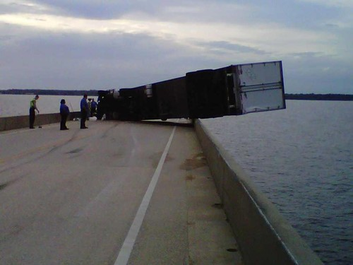
Notes:
Another slide that you can use to get the students involved with the presentation. Before advancing the slide to display the various terms, ask if they know what the different locations are (i.e. point to the abutment and ask if they know what the support at the bridge ends are called).

Slide 5
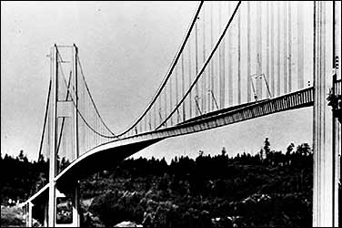
Tacoma Narrows Bridge (WA)
The first Tacoma Narrows Bridge opened to traffic on July 1, 1940.

Slide 6
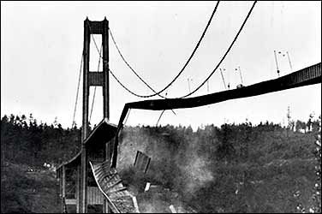
Tacoma Narrows Bridge
Its main span collapsed into the Tacoma Narrows four months later on November 7, 1940, at 11:00 AM

Slide 7
Tacoma Narrows Bridge
Notes:
In general this is a flow chart of the steps engineers follow in solving problems.
First, you identify and define your problem
Second, you analyze the problem
Third you design and propose solutions
Forth you refine your proposal
5) And after going through this process you have hopefully found a solution to your initial problem.

Slide 8
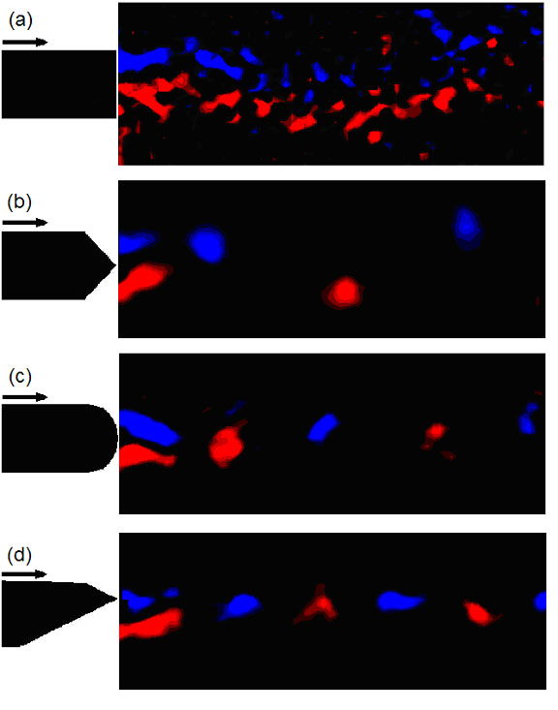
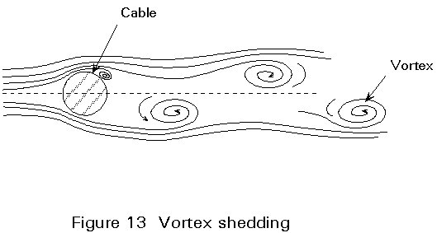
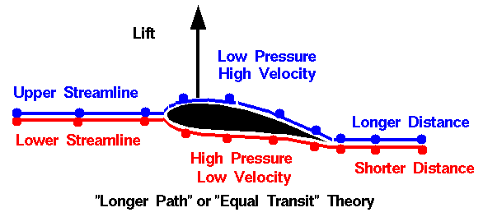

Slide 9
Engineering Process
PLAN
DESIGN
MAINTAIN
BUILD
TEST
Notes:
In general this is a flow chart of the steps engineers follow in solving problems.
First, you identify and define your problem
Second, you analyze the problem
Third you design and propose solutions
Forth you refine your proposal
5) And after going through this process you have hopefully found a solution to your initial problem.

Slide 10
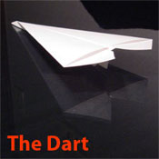
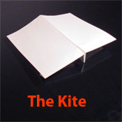
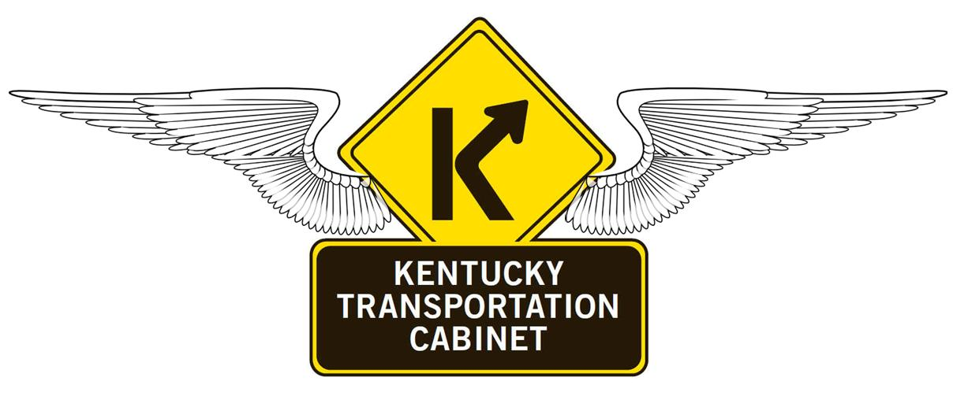
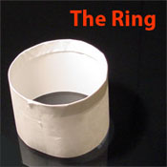
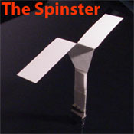

Slide 11
Questions?
Notes:
In general this is a flow chart of the steps engineers follow in solving problems.
First, you identify and define your problem
Second, you analyze the problem
Third you design and propose solutions
Forth you refine your proposal
5) And after going through this process you have hopefully found a solution to your initial problem.

